Slide 1



Primer Design Project
BIOL 6229
Gurmeet Kaur, Vaishali Jain, Mia Lin
Notes:
https://www.ncbi.nlm.nih.gov/nuccore/AE002098

Slide 2
Table of contents
01
02
03
04
Introduction & Background
Primer Set #1
Primer Set #2
Conclusion

Slide 3
01
Introduction & Background

Slide 4
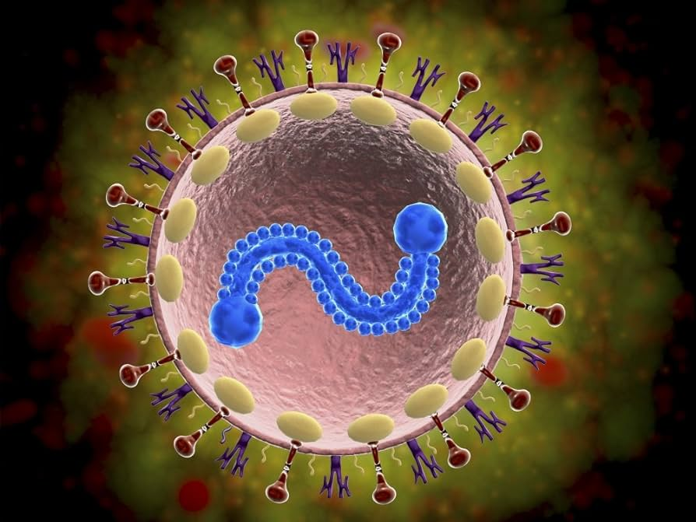
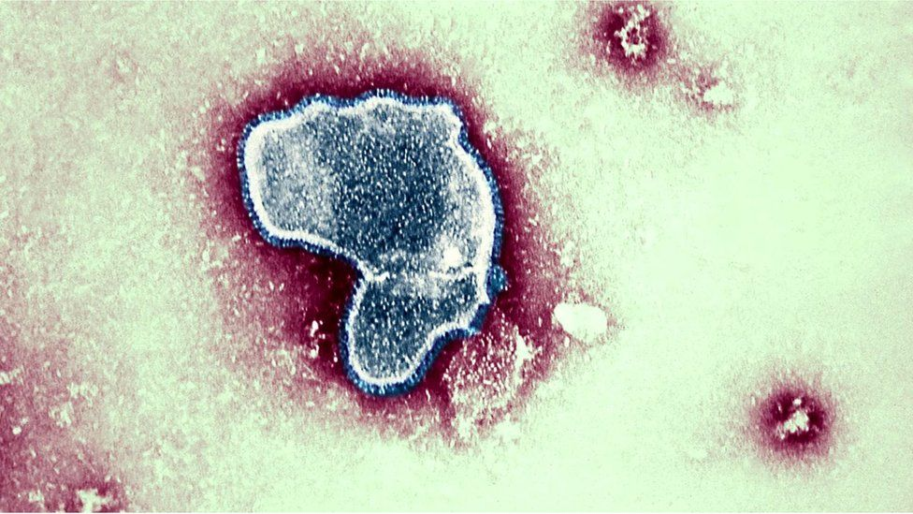
Introduction/Background
The design of primers for the identification and distinction of Human Respiratory Syncytial Virus (HRSV) strains is the main focus of the project.
A common pathogen that causes respiratory tract infections is the Human Respiratory Syncytial Virus (HRSV), which is especially harmful to newborns, young children, and people with compromised immune systems. It is a member of the Paramyxoviridae family and, particularly in vulnerable populations, is a major global cause of respiratory illness that results in significant morbidity and mortality (Böhmwald et al., 2016). HRSV A and HRSV B are the two primary groups into which HRSV strains are divided. The strains display notable genetic and antigenic variations, which are mainly ascribed to changes in the attachment glycoprotein G. As a target for antibody neutralization, the attachment glycoprotein is important for viral entry into host cells and interactions with host cell receptors (Böhmwald et al., 2016).

Slide 5
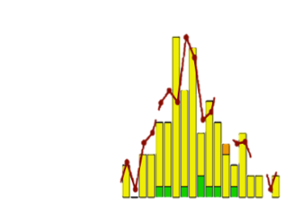
Justification for the Project
It is crucial to create targeted primers for the identification and distinction of HRSV strains for a number of reasons:
Since different strains of HRSV can differ in terms of virulence, transmissibility, and response to antiviral therapies, accurate identification of these strains is essential for clinical management (Melero & Moore, 2013).
Understanding the epidemiology of the virus, following outbreaks, and putting into practice successful public health interventions all depend on surveillance and monitoring of HRSV strains that are circulating within populations (Melero & Moore, 2013).
Research on viral evolution, pathogenesis, and vaccine development, among other topics, requires the ability to distinguish between different strains of HRSV (Melero & Moore, 2013).
The development and application of preventive measures, such as vaccination programs, can be influenced by knowledge of the distribution and prevalence of HRSV strains (Melero & Moore, 2013).

Slide 6
02
Primer Set #1

Slide 7

Primer Set #1
What is this primer set used for?
Blast query: BLAST sequences are aligned and region of interest to be amplified is clearly annotated.
Primer Design: The location of FOR and REV primer binding is clearly identified on the BLAST sequence, and the primers correctly flank the sequence of interest.
Primer pairs: Primers are optimal length, do not form dimers, secondary structure, have similar melting temperatures, and ~50% GC content.

Slide 8
03
Primer Set #2
Differentiating between HRSV strains

Slide 9
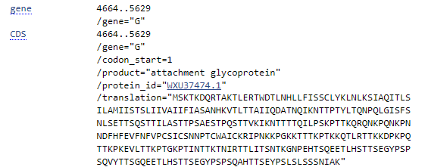
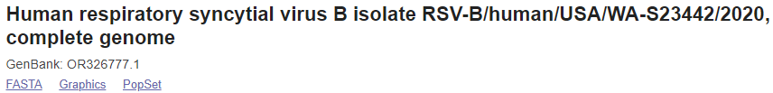
HRSV A VS B
HRSV strains have two main groups
HRSV A
HRSV B
Main difference between groups
Attachment glycoprotein G
Interacts with host cell receptors & target for neutralization of antibodies (de-Paris et al., 2014)

Slide 10
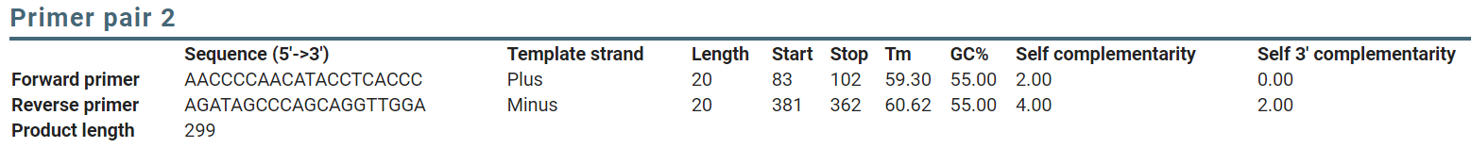
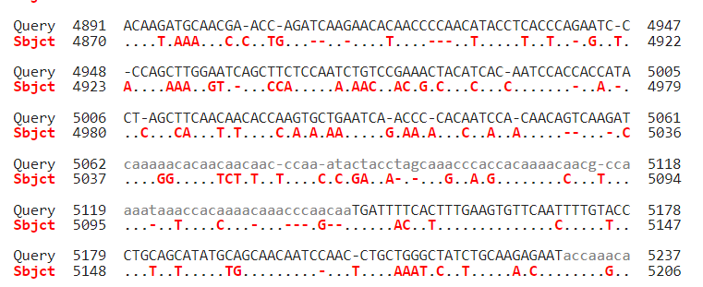
Primer Set differentiating A VS B
FOR
REV
Notes:
Through BLAST, We looked at the section that sequenced for G protein and found a subsection of interest. We then utilized Primer Blast and found a primer set that would differentiate between HRSV A and B. The primer set is at an optimal length of 20 sequences, have a low level of self complementarity, has similar melting temperatures and a GC content of around 50%. The target sequence has been highlighted in yellow and the primer binding for Forward and reverse are highlighted in blue.

Slide 11
04
Conclusion

Slide 12
Conclusion
The main goal is to create targeted primers for the identification and classification of strains of the Human Respiratory Syncytial Virus (HRSV). Serious respiratory tract infections with potentially fatal consequences are caused by HRSV, a pathogen of great importance that primarily affects infants, young children, and immunocompromised individuals. It is essential to comprehend the diversity of HRSV strains due to its worldwide influence on morbidity and mortality (Böhmwald et al., 2016).
The two main groups of HRSV strains, HRSV A and HRSV B, are distinguished by genetic and antigenic variations mainly ascribed to alterations in the attachment glycoprotein G. This glycoprotein is a target for antibody neutralization and is necessary for the virus to enter host cells and interact with host cell receptors. Different HRSV strains may differ in their virulence, transmissibility, and reaction to therapies as a result of these genetic and antigenic variations (Melero & Moore, 2013). HRSV A accession number PP530264 and HRSV B accession number OR326777.1 were used for this project.

Slide 13
Conclusion
In the beginning, precise strain identification of HRSV is essential for clinical management since it guides treatment choices and aids in prognosticating disease outcomes, then in order to comprehend the virus's epidemiology, track outbreaks, and carry out successful public health interventions, surveillance and monitoring of circulating HRSV strains are essential (Melero & Moore, 2013).
The research on viral evolution, pathogenesis, and vaccine development all depend on the ability to differentiate between HRSV strains. Information about the distribution and prevalence of HRSV strains can impact the creation and implementation of vaccination campaigns and other preventative measures (Melero & Moore, 2013).
This project intends to support disease control, species health, and scientific advancement by creating specialized primers designed for the identification and differentiation of HRSV strains. These primers could support continued research against respiratory infections caused by HRSV, improve clinical decision-making, and inform public health strategies. As a result, the project fills a vital gap in the field of virology and could have a big effect on general health.

Slide 14
References
https://www.ncbi.nlm.nih.gov/nuccore/PP530278.1
https://www.ncbi.nlm.nih.gov/nucleotide/OR326777.1?report=genbank&log$=nuclalign&blast_rank=13&RID=1129D69N016
de-Paris, F., Beck, C., de Souza Nunes, L., Pinheiro, A. M., Paiva, R. M., da Silva Menezes, D., Pires, M. R., dos Santos, R. P., de Souza Kuchenbecker, R., & Barth, A. L. (2014). Evaluation of respiratory syncytial virus group A and B genotypes among nosocomial and community-acquired pediatric infections in southern Brazil. Virology Journal, 11(1). https://doi.org/10.1186/1743-422x-11-36
Ye J, Coulouris G, Zaretskaya I, Cutcutache I, Rozen S, Madden T (2012). Primer-BLAST: A tool to design
target-specific primers for polymerase chain reaction. BMC Bioinformatics. 13:134. https://www.ncbi.nlm.nih.gov/tools/primer-blast/primertool.cgi?ctg_time=1712447108&job_key=-uEerLqmE4IssCi-SZAawFK9KNFBojXU
Böhmwald, K., Espinoza, J., Rey-Jurado, E., Gómez, R., González, P. A., Bueno, S. M., Riedel, C. A., & Kalergis, A. M. (2016). Human Respiratory Syncytial Virus: Infection and Pathology. Seminars in Respiratory and Critical Care Medicine, 37(04), 522–537. https://doi.org/10.1055/s-0036-1584799

Slide 15
Melero, J. A., & Moore, M. L. (2013). Influence of respiratory syncytial virus strain differences on pathogenesis and immunity. In Current Topics in Microbiology and Immunology (pp. 59–82). https://doi.org/10.1007/978-3-642-38919-1_3

